Slide 1

ROBOTICS COURSE – AUTONOMOUS CAR PROJECT
STEM
Notes:
Today we will be completing the BRONZE crest award

Slide 2
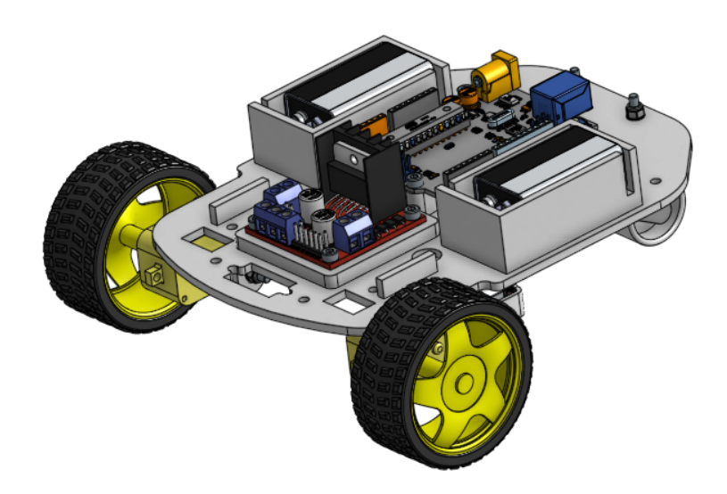
ROBOTICS COURSE – AUTONOMOUS CAR PROJECT
Motivation
Skills
CREST
Directing Staff
H&S

Slide 3
ROBOTICS COURSE – AUTONOMOUS CAR PROJECT
Day 1 | Day 2
Introduction to Arduino Programming | CREST Introduction
DC Motors | Planning your Project
Mechanical Build | Project Work
Electrical Build | Testing
Motor Programming | Team Presentations
Ultrasonic Sensor Programming
Autonomous Car Testing

Slide 4



Slide 5
STEM Icebreaker
Each time a question comes up, write your answer down on your whiteboard.
You will have 30s per slide
Still participate after you have been knocked out – you just wont be involved in the competition

Slide 6

90% Question

Slide 7
Question 1
If a motor needs 4J of energy to operate, and it has an efficiency of 80%, how much energy is required? (J – Joules, the unit of energy)

Slide 8
Answer
5J

Slide 9

75% Question

Slide 10
Question 2
Which gas makes up the majority of our atmosphere?

Slide 11
Answer
Nitrogen

Slide 12
50% Question

Slide 13
Question 3
Bob runs at 5mph for 2 hours. Dave runs at 8mph for 1.5hours. Who travels further and by what distance?

Slide 14
Answer
Dave, 2 miles more

Slide 15
30% Question

Slide 16
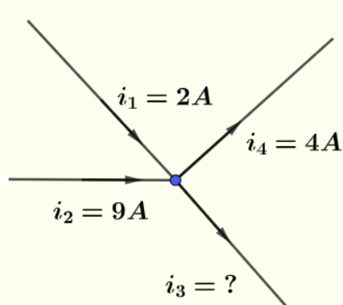
Question 4
What is the outputted current?

Slide 17
Answer
7 Amps

Slide 18
10% Question

Slide 19
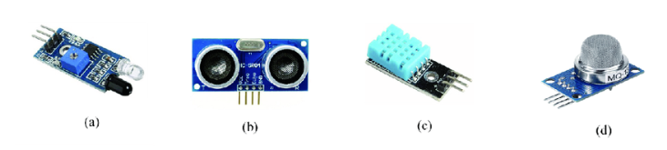
Question 5
Which of these sensors is used to measure distance?

Slide 20
Answer
B (Ultrasound)

Slide 21
5% Question

Slide 22
Question 6
What is an LED and why do we use them?

Slide 23
Answer
Light Emitting Diode
Only allow current to flow one way
Prevent catastrophic damage to system if current was to flow the wrong way

Slide 24
1% Question
1% Question

Slide 25
Question 7
What does clock speed mean and what is the clock speed on the Arduino Uno?

Slide 26
Answer
Number of computer cycles a CPU can do in a second.
16MHz

Slide 27
INRODUCTION TO ARDUINO
CWO Lucas Clark
STEM
Notes:
For some context about who I am and why im standing here, Im CWO Lucas Clark, I am currently doing my degree apprentiship with univeristy of sunderland and Procter and gamble, I spent a few months at the start of my career studying and using some arduinos / more advanced chips so I have some idea of what I am talking about.

Slide 28
INTRODUCTION TO ARDUINO
Objectives
By the end of the session, you will be able to:
Describe what an Arduino is
Discuss some examples of what type of devices can be controlled and used by an Arduino board.
Describe what the different types of 'Pins' are on an Arduino board and what they do
Describe how to program to an Arduino Board.

Slide 29
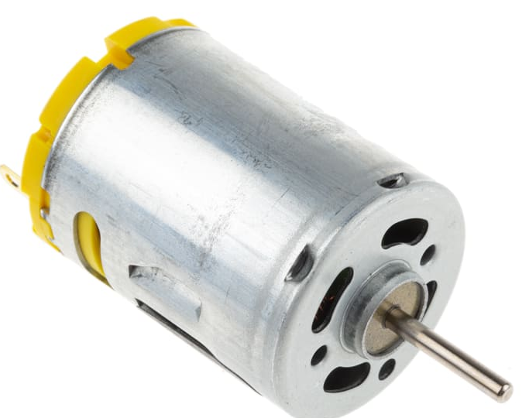
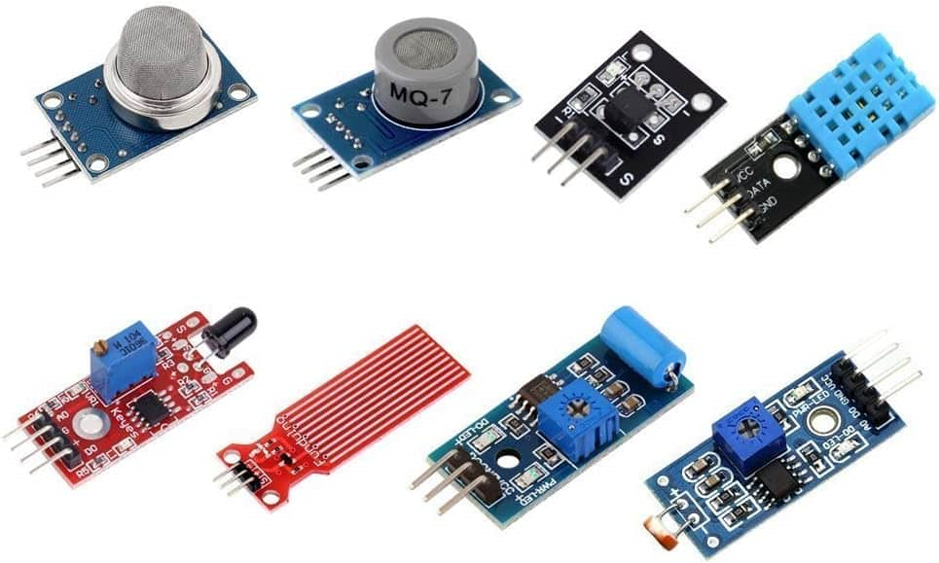

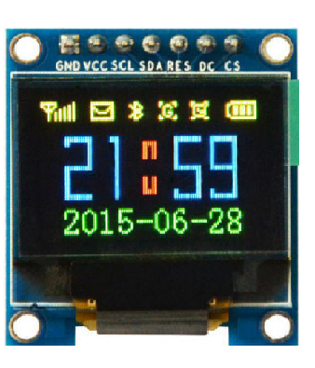
INTRODUCTION TO ARDUINO
What is an Arduino?
An Arduino board is a small computer that you can use to control electronic devices.
Like a tiny brain that can be programmed to do specific tasks and actions.
Notes:
An Arduino can be used to control and use a huge range of types of devices: motors, lights, displays, sensors and many more. Can you think of anything you might want to control to make a car?
The actual brain function of the arduino comes from the microprocessor which contains the code and logic that you code.
If you want to know more about how a microproccess works come and talk to me!

Slide 30
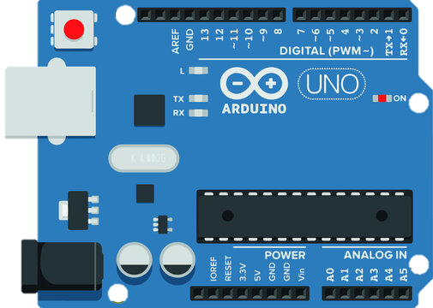
INTRODUCTION TO ARDUINO
Power
Analog
Digital
Notes:
There are 3 main types of pins on an Arduino board:
Power
Analog
Digital
Hand out the arduinos at this point.
Can you all identify where the types of pins are?

Slide 31
INTRODUCTION TO ARDUINO
Power Pins
Power pins allow for the powering of components connected to the board. To supply power to the board there are a few ways to do it.
There is a V_{in} pin on the board.
There is a barrel jack connector.
There is the USB-B connector.
The Arduino Uno requires between 6V - 20V power supply
Notes:
Point to the powering points

Slide 32
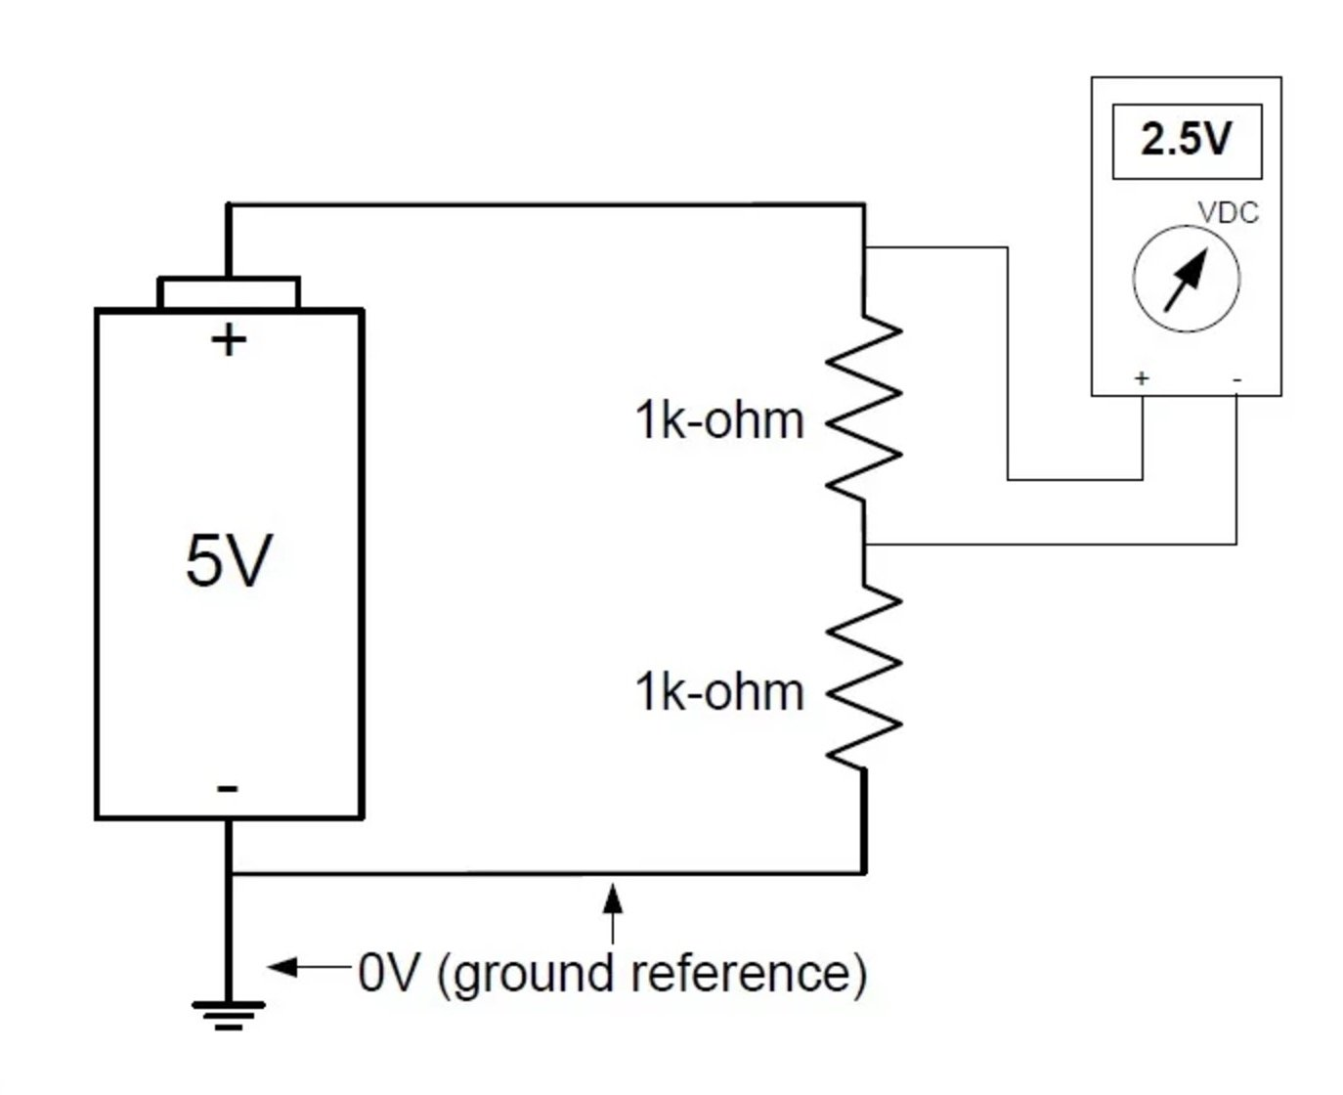
INTRODUCTION TO ARDUINO
Ground Pins (GND)
Grounding is required in all circuits just as Voltage / Power pins are
The current in a circuit travels from a power source such as a battery and travels towards the ground
This flow is what powers electrical devices
Ground pins have a few main purposes: completing circuits and providing a stable electrical reference point.
This allows for the smooth running of devices and the completion of the circuit.

Slide 33
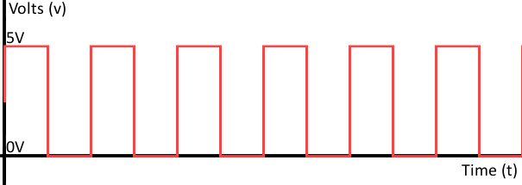
INTRODUCTION TO ARDUINO
Digital Pins
Digital signals are discrete signals. This means they can either be on or off.
Notes:
Can you think of any examples of devices which may use digital signals ie: on and off?

Slide 34
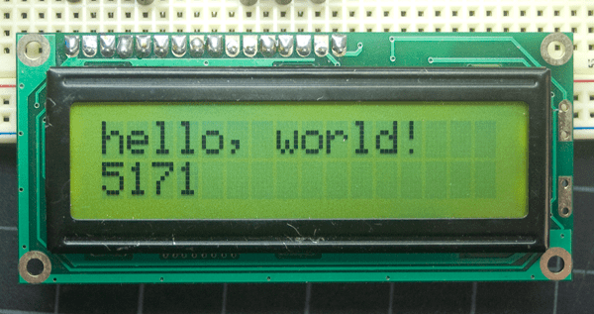

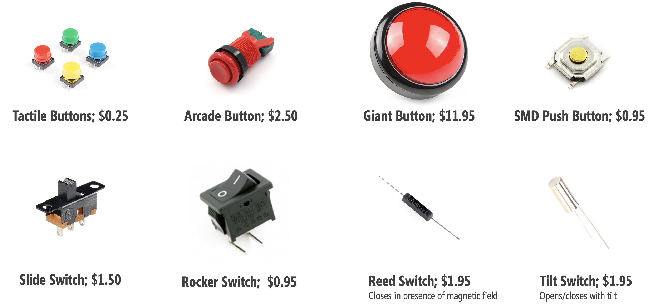
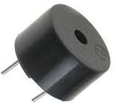
INTRODUCTION TO ARDUINO
Digital Signal Devices
Notes:
Can you think of any examples of deivces which may use digital signals ie: on and off?

Slide 35
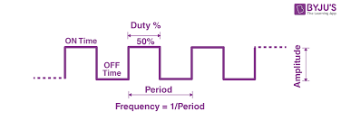
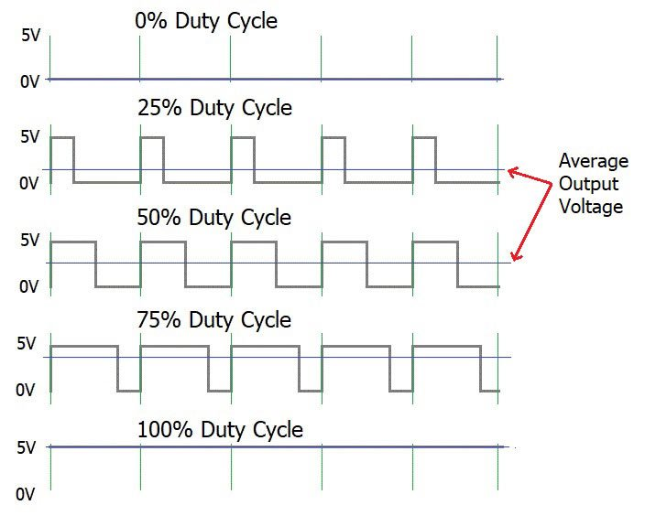
INTRODUCTION TO ARDUINO
Digital Pins - PWM
Pulse Width Modulation (PWM) is a technique used to control the amount of power delivered to a load by changing the width of a 'pulse'.
PWM can simulate varying levels of analog voltage, enabling precise control of devices such as motors, LEDs, and audio amplifiers.
Notes:
Can you think of any reason as to why we might use PWM?

Slide 36
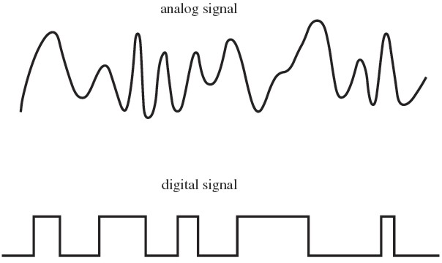
INTRODUCTION TO ARDUINO
Analog Pins
Unlike digital signals that are either high (5V) or low (0V), analogue signals can take on any value within this range.
Analogue signals are great for sensors where you want very precise information.
Notes:
The Arduino's analog pins have an Analog-to-Digital Converter (ADC) that converts these analog voltages into digital values that the microcontroller can process, enabling the Arduino to read and respond to analog inputs from sensors or other devices. This allows for a wide range of applications where precise measurement and control of analog quantities are needed, such as in environmental monitoring, audio processing, and sensor-based systems.

Slide 37
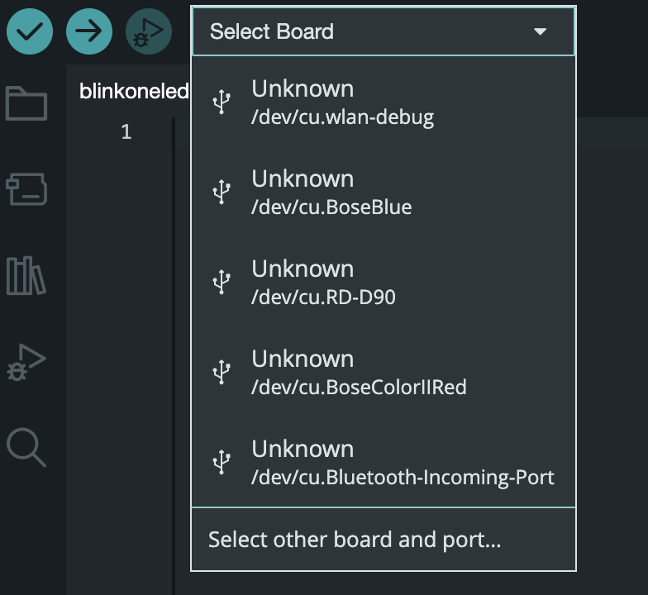
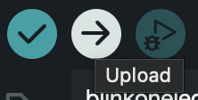
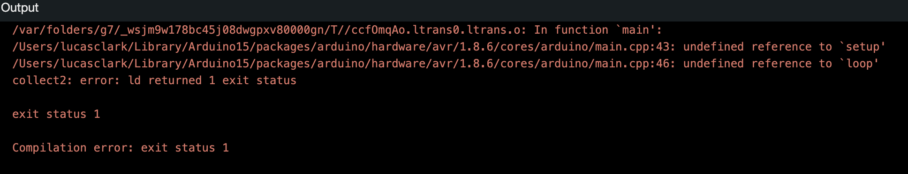
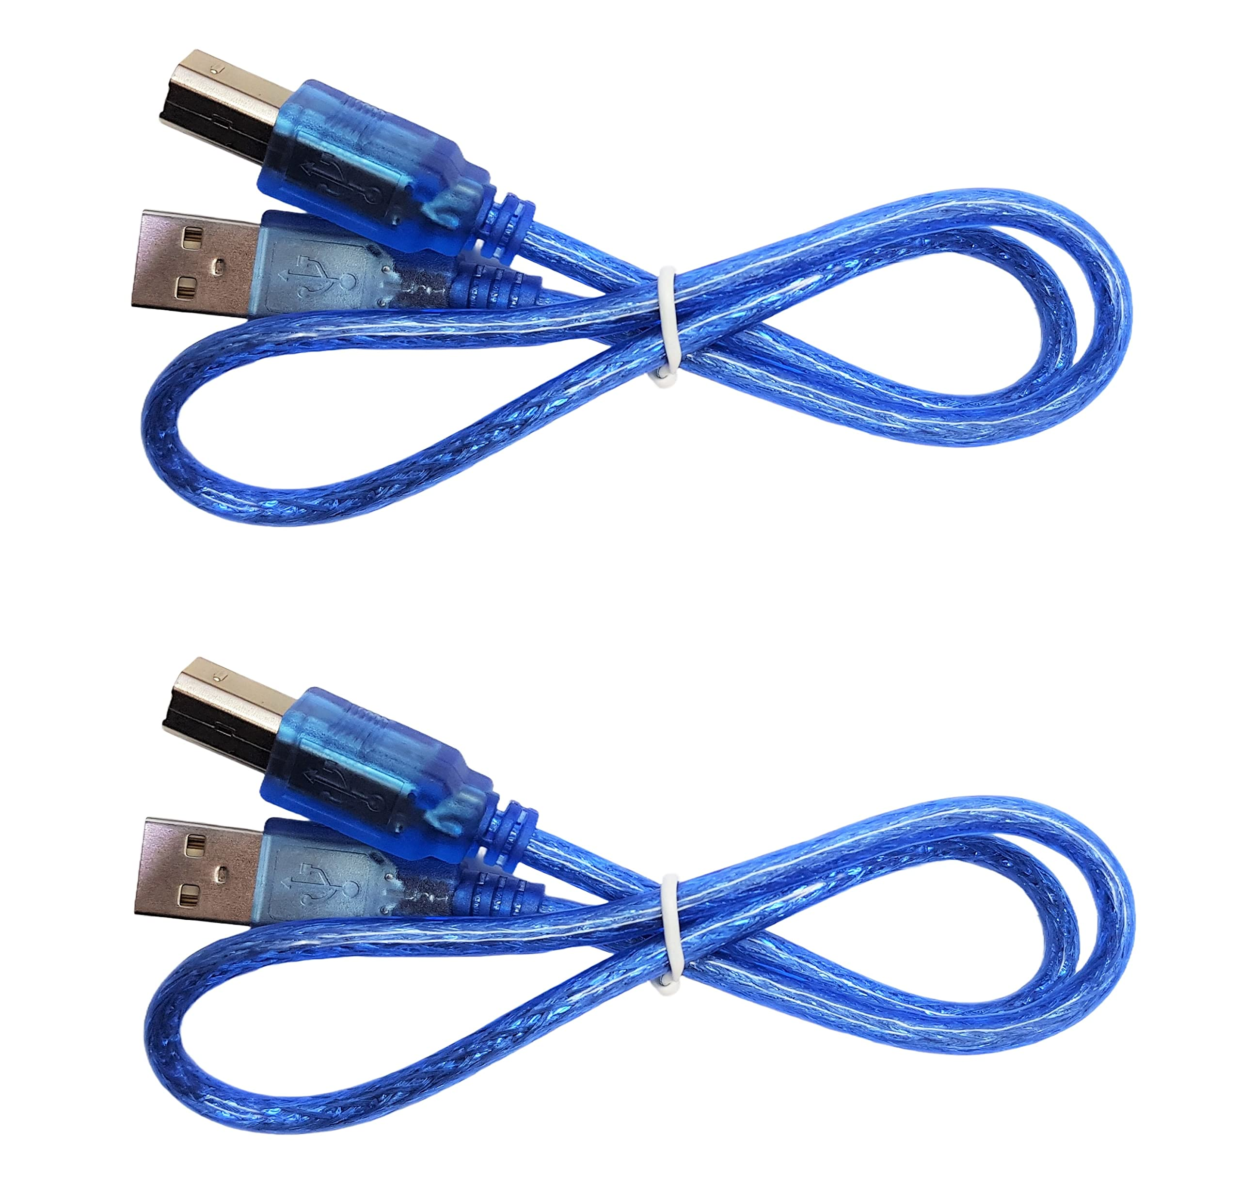
INTRODUCTION TO ARDUINO
How to Program Arduino
Arduinos can be programmed using the Integrated Development Environment (IDE). We program what we want each pin to output/input
Notes:
Get them to open up their IDEs walk through all of the points in message, make sure they all know where all of the buttons are.
Errors will be highlighted and you can use this error message to decipher what is wrong with your code.

Slide 38
INTRODUCTION TO ARDUINO
Any Questions?
Notes:
Get them to open up their IDEs walk through all of the points in message, make sure they all know where all of the buttons are.
Errors will be highlighted and you can use this error message to decipher what is wrong with your code.

Slide 39
INRODUCTION TO PROGRAMMING
FS Adam McKenna
STEM
Notes:
Today we will be completing the BRONZE crest award

Slide 40
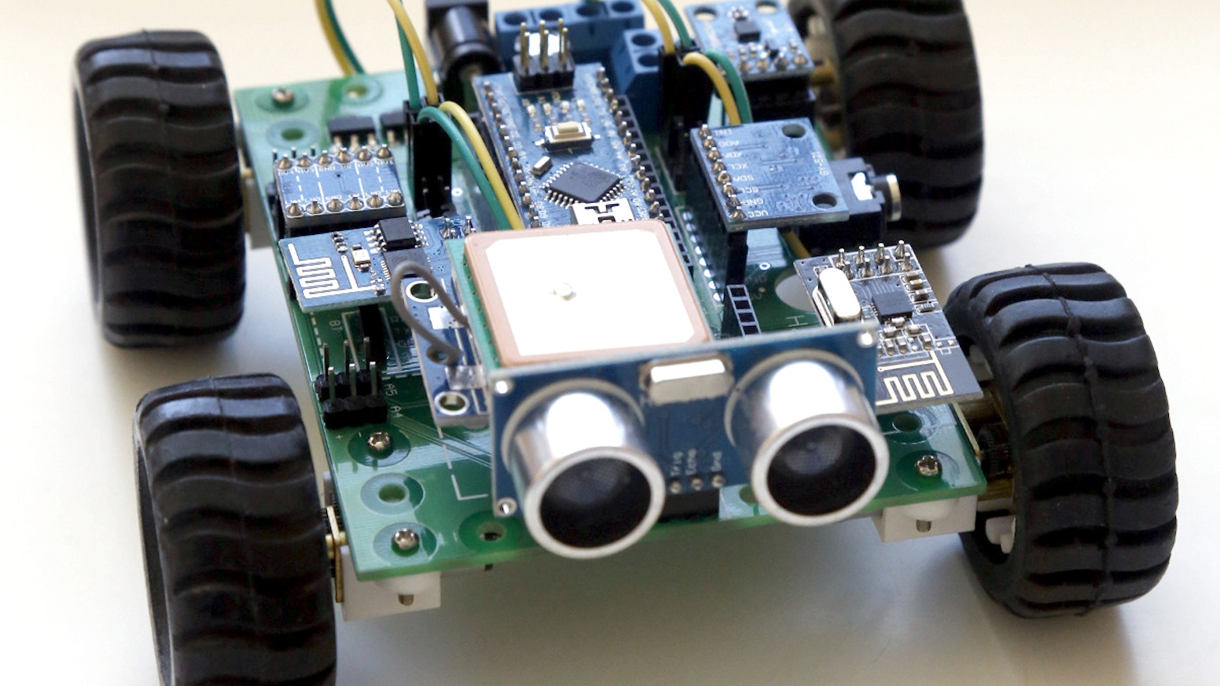
INTRODUCTION TO PROGRAMMING
Objectives
You should know:
What an Arduino is, what its components are and a basic understanding of how it will work.
What will you cover now?
How to get an output from your Arduino? What does an IDE look like and how do we write code?

Slide 41
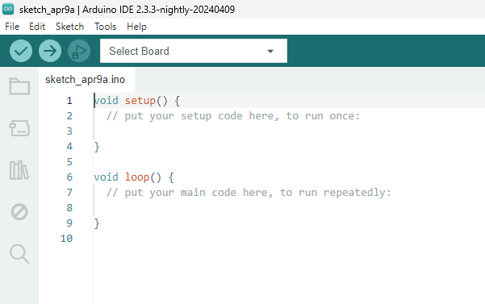
INTRODUCTION TO PROGRAMMING
Navigating the IDE
IDE stands for Integrated Development Environment
The upload button is how we transfer the code to the Arduino
This is where you select the board you are wanting to use
This is where the code you write will go

Slide 42
INTRODUCTION TO PROGRAMMING
Functions
Functions are self-contained modules of code
Setup will run when the code is initialised. It will only run once. It is used to set pin modes and start the Serial Monitor.
Loop will run infinitely once setup function has ran. Loop is where our code is going to go. It will constantly cycle through.
What does this mean?

Slide 43
INTRODUCTION TO PROGRAMMING
Functions
Program will start when after you Upload it
Start
Setup()
Setup Function executes automatically after program starts
Loop()
Loop Function starts after Setup and repeats forever

Slide 44
INTRODUCTION TO PROGRAMMING
Going Forward
You should now know:
How to get an output from your Arduino, What an IDE looks like and how to write code. You are now all programmers!

Slide 45
DC MOTORS
SGT Annabelle Larmour
STEM
Notes:
Brief explanation of what a DC motor does and how they are powered. Walk through powering using the 5v and GND pins, control direction by swapping pins around, reduce speed by using the 3.3v pins. Explain why a Motor Driver is needed.

Slide 46
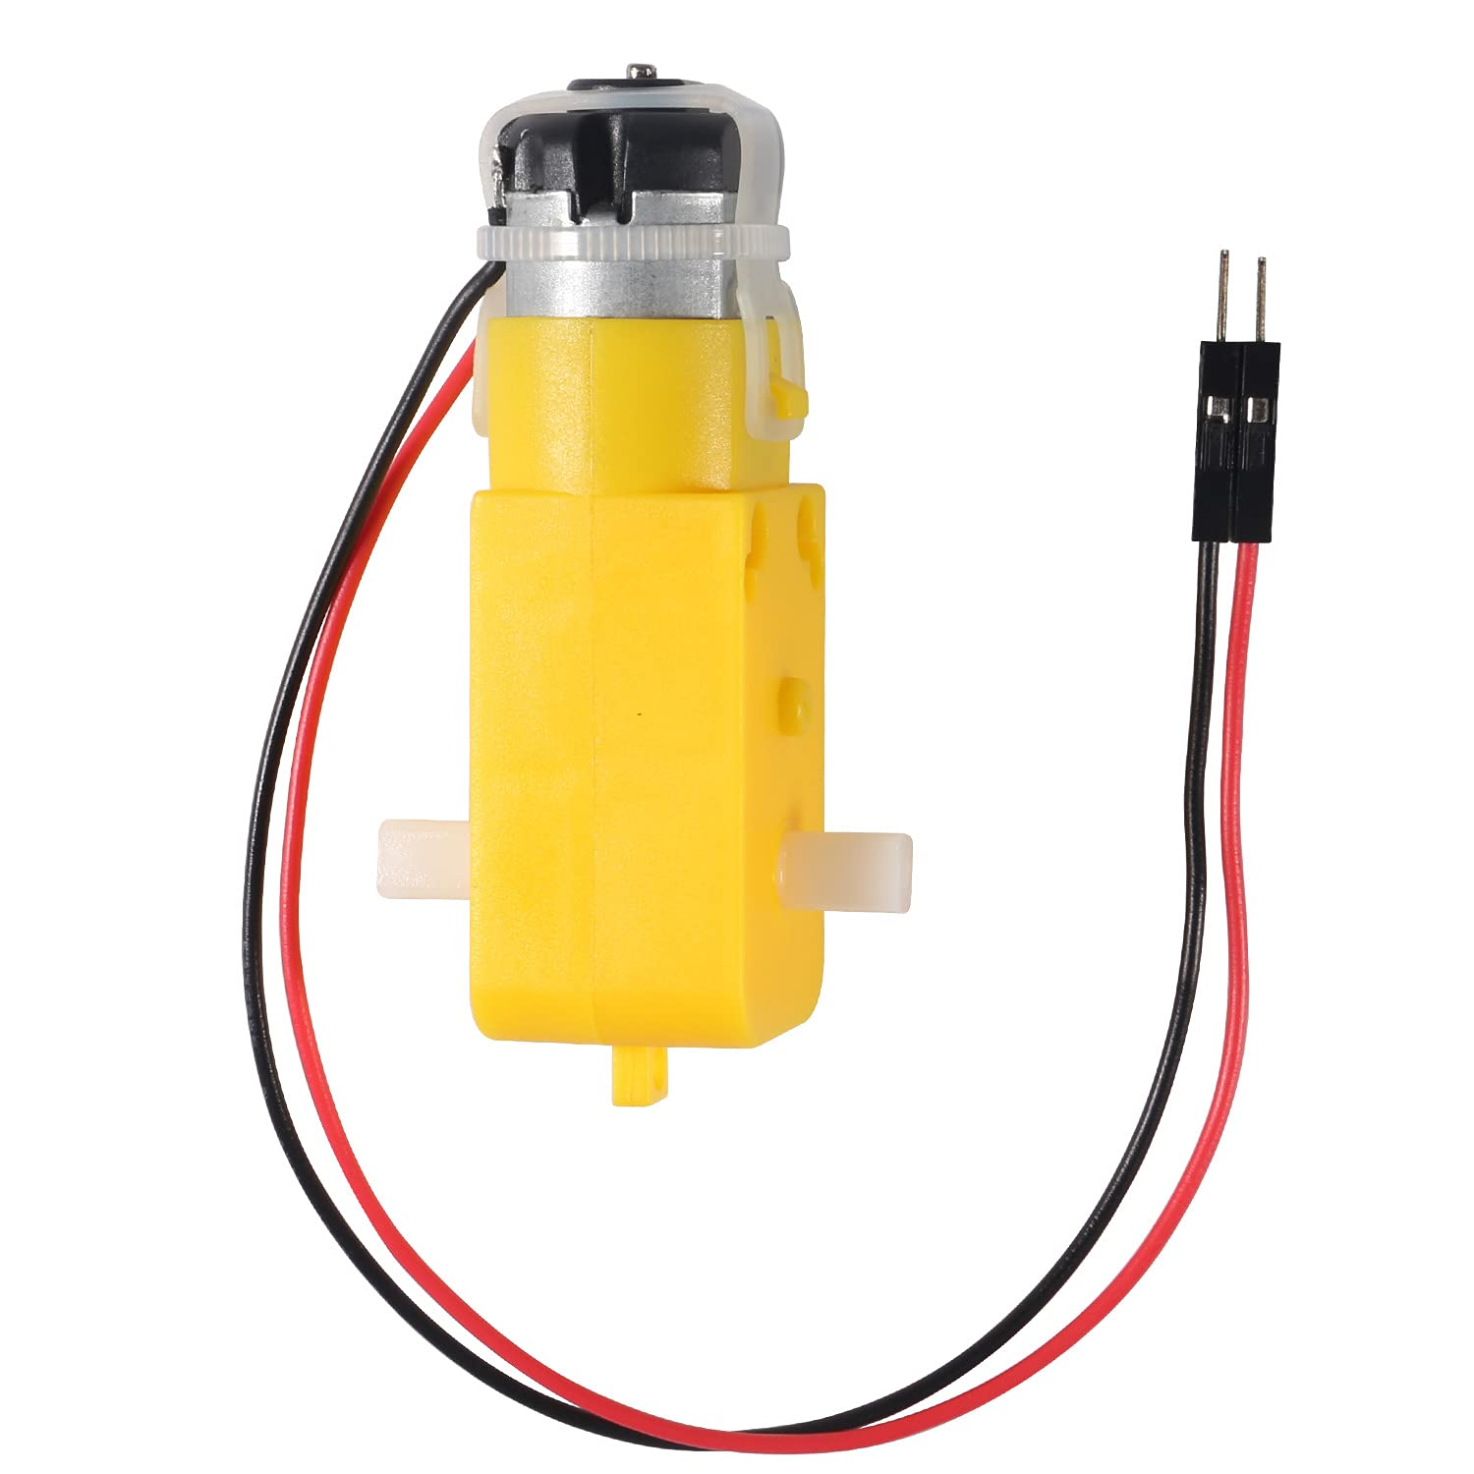
DC MOTORS
What does it look like?

Slide 47
MECHANICAL BUILD
FLT LT Glenn Milburn
STEM
Notes:
How to assemble bots, cover how to read Assy drawings, BOMs, part and fixing names, balloons, exploded views, correct chassis orientation, assembly notes. Discuss why nylocs are used with washers, overtightening. Tool H&S brief.
DS to support, catch errors but allow teams to make their own, balance time impact and learning opportunity. Watch out for H&S issues.

Slide 48
ELECTRICAL BUILD
SGT Annabelle Larmour
STEM
Notes:
How to read wiring diagram, jumper wires, Male and Female ends, screw terminals (safety tug), splicing wires. Do not plug 9V Batteries in until checked by DS.
DS to support, when teams are ready, all wiring must be checked. Incorrect wiring will lead to short circuiting.

Slide 49
MOTOR CONTROL
PLT OFF Harrison Milburn
STEM
Notes:
Arduino script to send digital signals from Arduino to Motor Driver. Control each wheel individually with car on mount. Direction and speed control. Handout after teaching with code. Commenting Code. Variables. Do a straight-line race.

Slide 50
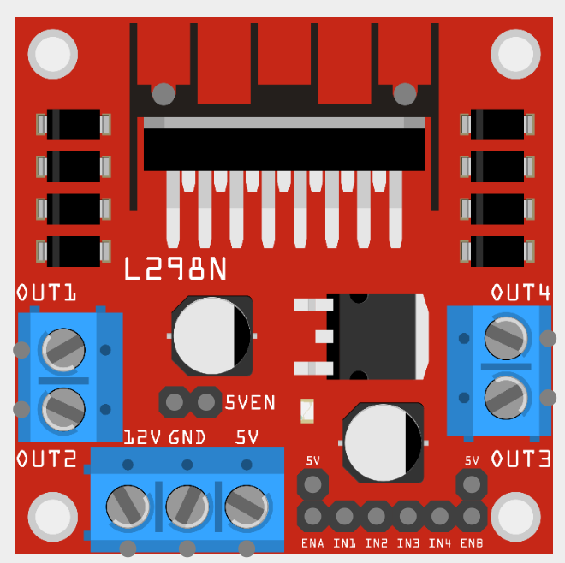
MOTOR CONTROL
L298N Motor Driver
Motor #1 Power
Motor #2 Power
Motor #1 Ground
Motor #2 Ground
Battery Ground
Battery Power
Speed and Direction Control

Slide 51
INTRODUCTION TO PROGRAMMING
L298N Motor Driver
Motor #2 Speed
Motor #1 Speed
Motor #1 Clockwise
Motor #2 Counter-Clockwise
Motor #1 Counter-Clockwise
Motor #2 Clockwise

Slide 52
ULTRASONIC SENSOR
FS Adam McKenna
STEM
Notes:
Fit Ultrasonic sensor (However teams want to). Guide cadets to website to learn how the ultrasonic sensor works. Write new script to print distance to the serial monitor.

Slide 53
ULTRASONIC SENSOR
Objectives
What will you learn now?
What is an ultrasonic sensor. How to deal with unknown environments. Thinking like an engineer

Slide 54
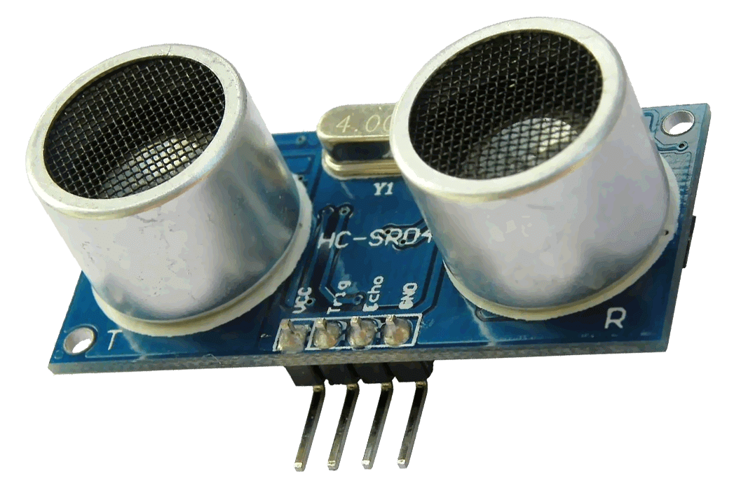
ULTRASONIC SENSOR
HC-SR04
Ultrasonic sensors are used to measure distance.
Based on this image, how do you think they do this?

Slide 55
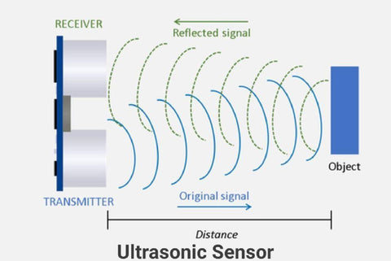
ULTRASONIC SENSOR
How it Works

Slide 56
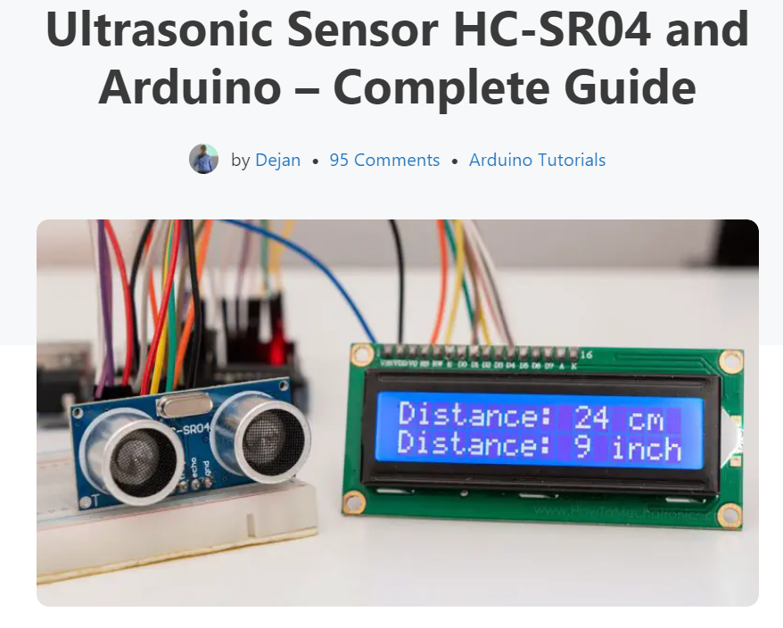
ULTRASONIC SENSOR
You Figure it Out
Now we understand how this device works, how to we implement this into our robot?
Thats for you as engineers to find out. Google "How to Mechatronics Ultrasonic sensor“
Wire in the sensor and write a new Arduino program which outputs the distance from the sensor to the Serial Monitor

Slide 57
ULTRASONIC SENSOR
Next Steps
You should now know:
What an ultrasonic sensor is, now how can we use it in our cars?

Slide 58
AUTONOMOUS CAR
PLT OFF Harrison Milburn
STEM
Notes:
Walk through algorithm step to step for autonomous control. Code walk-through for using if else statements but leave actual code to teams. Support teams and provide help where needed.
Cadets to program their bots for autonomous control. DS to support and talk-through code to help teams get a good result. If teams do well, propose ways of making the code better.

Slide 59
AUTONOMOUS CAR
The Algorithm
Start
Is Distance Small?
Setup()
Find Distance
NO
Drive Forwards
YES
Stop
This is the loop() function!
Rotate

Slide 60
DEBREIF
STEM
Notes:
Round up on success of Autonomous control
Set expectations and goals for Day 2

Slide 61
ROBOTICS COURSE – AUTONOMOUS CAR PROJECT
STEM

Slide 62
CREST AWARDS
CWO Lucas Clark
STEM
Notes:
Describe what CREST Awards are and why they’re important, that they’re cadet led, requires a workbook to be filled in.

Slide 63
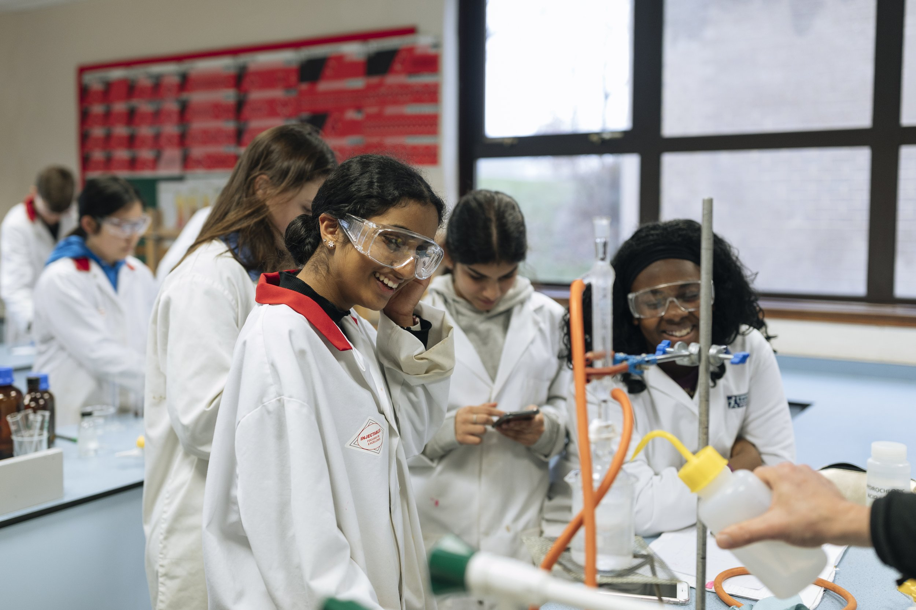
CREST AWARDS
What is a CREST Award?
Designed to get teens like you to think like scientists and engineers
CREST is a Nationally recognised award great for College, University and Job applications
CREST is the best way to include STEM to your parade nights

Slide 64

CREST AWARDS
Levels of Award
DISCOVERY
5 HOURS
£3
BRONZE
10 HOURS
£5
SILVER
30 HOURS
£10
GOLD
70 HOURS
£20

Slide 65
CREST AWARDS
Levels of Award
BRONZE
10 HOURS
£5
5 PARADE NIGHTS
OR
1 FULL WEEKEND
MORE COMPLEX PROJECT
BEST FOR 14-16 YEAR OLDS

Slide 66
CREST AWARDS
How They Work
Cadets Choose Project
Research Project
Plan Project
Execute Plan
Consolidate Results
Present Findings
Complete CREST Workbook Throughout

Slide 67

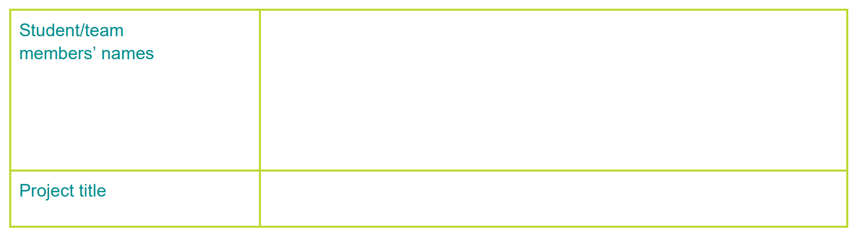




CREST AWARDS
BRONZE PASS CRITERIA
PLANNING
PROJECT
CONSOLIDATION
PROJECT-WIDE
1.1 Clear Project Aim
2.1 Good Use of Resources
3.1 Project Conclusions
4.1 Scientific Understanding
1.2 Project Purpose
2.2 Research and Referencing
3.2 Personal Contribution
4.2 Safety Considerations
1.3 Multiple Approaches
3.3 Project Reflection
4.3 Creative Thinking
1.4 Had a Project Plan
4.4 Problem Solving
1.5 Time Management
4.5 Project Presentation
Notes:
To pass the course you must complete / meet 11 of the 15 criteria, these are written within your booklets.

Slide 68
CREST PROJECTS
FLT LT Glenn Milburn
STEM
Notes:
Describe the options for teams to select from, talk them through and offer possible paths to success for each, allow teams to select based on ability level.

Slide 69
CREST PROJECTS
Choose Your Project!
Better Rotation
Obstacle Course
RADAR Car
Remote Controlled Car
Random Rotation
Make Your Own Project

Slide 70
PROJECT WORK
STEM

Slide 71
